Slide 1
Chapter 3: GUI
Look
And
Feel Customization

Slide 2
Chapter 3:
Look and Feel Customization
In this chapter, We will also introduce a few new widgets that tkinter offers us.
In the Creating tooltips using Python recipe, we will create a ToolTip OOP-style class.
You will learn how to create different message boxes, change the GUI window title, and much more. We will be using a spin box control to learn how to apply different styles.

Slide 3
Look and Feel Customization Chapter 3
Content
Creating message boxes – the information, warning, and error
Create independent message boxes
Create the title of a tkinter window form
Changing the icon of the main root window
Using a spin box control
Applying relief – sunken and raised appearance of widgets
Creating tooltips using Python
Adding Progressbar to the GUI
Use the canvas widget

Slide 4
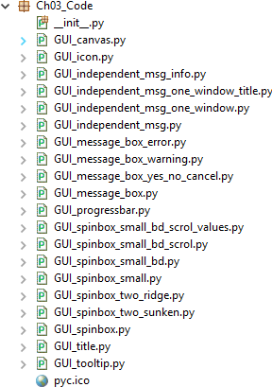
Here is the overview of the Python modules for this chapter:

Slide 5
Look and Feel Customization Chapter 3
1. Creating message boxes – information, warning, and error
A message box is a pop-up window that gives feedback to the user. It can be informational, hinting at potential problems, as well as catastrophic errors.
Using Python to create message boxes is very easy.
Getting ready
We will add functionality to the Help | About menu item we created in Chapter 2, Layout Management, in the Creating tabbed widgets recipe.
The code is from GUI_tabbed_all_widgets_both_tabs.py. The typical feedback to the user when clicking the Help | About menu in most applications is informational. We'll start with this information and then vary the design pattern to show warnings and errors.

Slide 6
Look and Feel Customization
Chapter 3
How to do it…
Here are the steps to follow to create a message box in Python:
Open GUI_tabbed_all_widgets_both_tabs.py from Chapter 2, Layout Management, and save the module as GUI_message_box.py.
Add the following line of code to the top of the module where the import statements live:
from tkinter import messagebox as msg
Next, create a callback function that will display a message box. We have to place the code of the callback above the code where we attach the callback to the menu item, because this is still procedural and not OOP code.

Slide 7
Look and Feel Customization
Chapter 3
Add the following code just above the lines where we create the help menu:
def _msgBox():
msg.showinfo('Python Message Info Box', 'A Python GUI created using tkinter:\nThe year is 2019.')
The preceding instructions produce the following code, GUI_message_box.py:

Slide 8
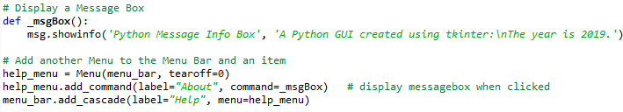
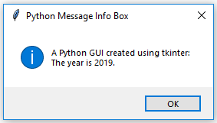
Look and Feel Customization
Chapter 3
4. Run the code. Clicking Help | About now causes the following pop-up window to appear:

Slide 9
Look and Feel Customization
Chapter 3
Let's transform this code into a warning message box pop-up window instead:
Open GUI_message_box.py and save the module as
GUI_message_box_warning.py.
Comment out the msg.showinfo line.
Replace the information box code with warning box code:
msg.showwarning('Python Message Warning Box', 'A Python GUI created using tkinter:' '\nWarning: There might be a bug in this code.')

Slide 10

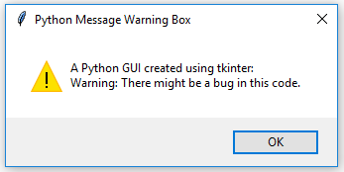
Look and Feel Customization
Chapter 3
The preceding instructions produce the following code,
GUI_message_box_warning.py:
4. Running the preceding code will now result in the following slightly modified message box:

Slide 11
Look and Feel Customization Chapter 3
Displaying an error message box is simple and usually warns the user of a serious problem. As we did in the previous code snippet, comment out the previous line and add the following code, as we have done here:
Open GUI_message_box_warning.py and save the module as
GUI_message_box_error.py.
Replace the warning box code with error box code:
msg.showerror('Python Message Error Box', 'A Python GUI created using tkinter:'
'\nError: Houston ~ we DO have a serious PROBLEM!')

Slide 12
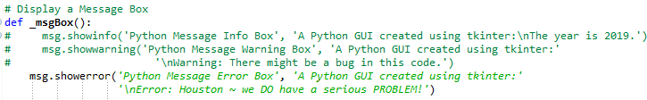
Look and Feel Customization Chapter 3
The preceding instructions produce the following code:

Slide 13
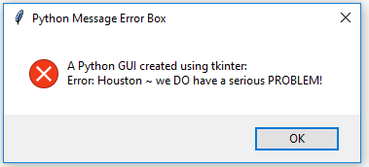
3. Run the GUI_message_box_error.py file. The error message looks like this:
There are different message boxes that display more than one OK button, and we can program our responses according to the user's selection.
The following is a simple example that illustrates this technique:
1. Open GUI_message_box_error.py and save the module as GUI_message_box_yes_no_cancel.py.

Slide 14
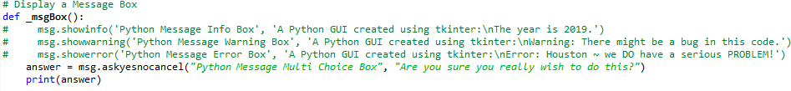
Look and Feel Customization
Chapter 3
2. Replace the error box with a yes_no_cancel box:
answer = msg.askyesnocancel("Python Message Multi Choice Box", "Are you sure you really wish to do this?")
The preceding instructions produce the following code:

Slide 15
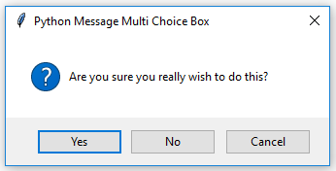

Look and Feel Customization
Chapter 3
3. Run the GUI_message_box_yes_no_cancel.py file. Running this GUI code results in a popup whose user response can be used to branch on the answer of this event-driven GUI loop, by saving it in the answer variable:
The console output using Eclipse shows that clicking the Yes button results in the Boolean value of True being assigned to the answer variable:

Slide 16
Look and Feel Customization
Chapter 3
For example, we could use the following code:
If answer == True:
<do something>
Clicking No returns False and Cancel returns None
Now, let's go behind the scenes to understand the code better.

Slide 17
Look and Feel Customization
Chapter 3
2. Create independent message boxes
In this recipe, we will create our tkinter message boxes as standalone top-level GUI windows.
You will first notice that, by doing so, we end up with an extra window, so we will explore ways to hide this window.
In the previous recipe, we invoked tkinter message boxes via our Help | About menu from our main GUI form.

Slide 18
Look and Feel Customization
Chapter 3
Getting ready
We have already created the title of a message box in the previous recipe, Creating message boxes - information, warning, and error. We will not reuse the code from the previous recipe, but build a new GUI using very few lines of Python code.
How to do it…
We can create a simple message box as follows:
Create a new module and save it as GUI_independent_msg.py.
Add the following two lines of code, which is all that is required:
from tkinter import messagebox as msg
msg.showinfo('Python GUI created using tkinter:\nThe year is 2019')

Slide 19
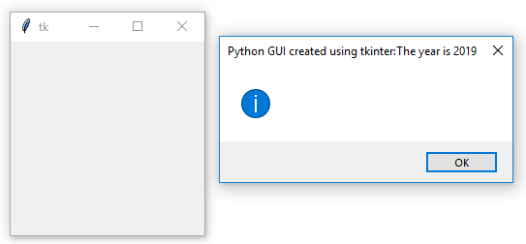
Look and Feel Customization
Chapter 3
Run the GUI_independent_msg.py file. This will result in the following two windows:

Slide 20
Look and Feel Customizatio Chapter 3
Let's solve this now. We can change the Python code by adding a single or double quote followed by a comma:
Open GUI_independent_msg.py and save the module as
GUI_independent_msg_info.py.
Create an empty title:
from tkinter import messagebox as msg
msg.showinfo('', 'Python GUI created using tkinter:\nThe year is 2019')
Run the GUI_independent_msg_info.py file. Now, we do not have a title but our text ended up inside the popup, as we had intended:

Slide 21
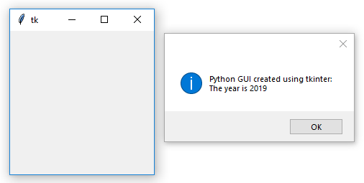
The first parameter is the title and the second is the text displayed in the pop-up message box. By adding an empty pair of single or double quotes followed by a comma, we can move our text from the title into the pop-up message box.
We still need a title, and we definitely want to get rid of this unnecessary second window. The second window is caused by a Windows event loop. We can get rid of it by suppressing it.

Slide 22
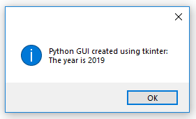
Look and Feel Customization
Chapter 3
Add the following code:
Open GUI_independent_msg_info.py and save the module as
GUI_independent_msg_one_window.py.
Import Tk create an instance of the Tk class, and call the withdraw method:
from tkinter import Tk root = Tk() root.withdraw()
Now, we have only one window. The withdraw() method removes the debug window that we are not interested in having floating around.
Run the code. This will result in the following window:

Slide 23
Look and Feel Customization
Chapter 3
In order to add a title, all we have to do is place string into our empty first argument.
For example, consider the following code snippet:
Open GUI_independent_msg_one_window.py and save the module as
GUI_independent_msg_one_window_title.py.
Give it a title by adding some words into the first argument position:
msg.showinfo('This is a Title', 'Python GUI created using tkinter:\nThe year is 2019')

Slide 24

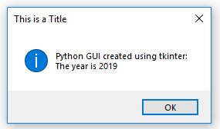
Look and Feel Customization
Chapter 3
The preceding instructions produce the following code:
3. Run the GUI_independent_msg_one_window_title.py file.
Now, our dialog has a title, as shown in the following screenshot:

Slide 25
Look and Feel Customization Chapter 3
3. How to create the title of a tkinter window form
How to create independent message boxes. We just pass in a string as the first argument to the constructor of the widget.
Getting ready
Instead of a pop-up dialog window, we create the main root window and give it a title.

Slide 26
Look and Feel Customization Chapter 3
How to do it…
The following code creates the main window and adds a title to it. Here, we just focus on this aspect of our GUI:
Open GUI_tabbed_all_widgets_both_tabs.py save the module as GUI_title.py.
Give the main window a title:
import tkinter as tk win = tk.Tk() win.title("Python GUI")
# Create instance
# Add a title

Slide 27
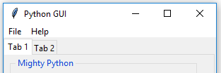
Look and Feel Customization Chapter 3
3. Run the GUI_title.py file. This will result in the following two tabs:
Now, let's go behind the scenes to understand
the code better.

Slide 28

Look and Feel Customization Chapter 3
4. Changing the icon of the main root window
One way to customize our GUI is to give it an icon different from the default icon that ships out of the box with tkinter.
Getting ready
We are improving our GUI from the Creating tabbed widgets recipe in Chapter 2, Layout Management. We will use an icon that ships with Python, but you can use any icon you find useful. Make sure you have the full path to where the icon lives in your code, or you might get errors.
How to do it…
For this example, I have copied the icon from where I installed Python 3.7 to the same folder where the code lives. The following screenshot shows the icon that we will be using:

Slide 29

Look and Feel Customization
Chapter 3
In order to use this or another icon file, perform the following steps:
Open GUI_title.py and save the module as GUI_icon.py.
Place the following code above the main event loop:
# Change the main windows icon win.iconbitmap('pyc.ico')
Run the GUI_icon.py file. Observe how the feather default icon in the top-left corner of the GUI changed:

Slide 30
5. Using a spin box control
In this recipe, we will use a Spinbox widget, and we will also bind the Enter key on the keyboard to one of our widgets. The Spinbox widget is a one-line widget, like the Entry widget, with the additional capability to restrict the values it will display. It also has some small up/down arrows to scroll up and down between the values.
Look and Feel Customization Chapter 3
Getting ready
We will use our tabbed GUI, from the How to create the title of a tkinter window form recipe, and add a Spinbox widget above the ScrolledText control. This simply requires us to increment the ScrolledText row value by one and insert our new Spinbox control in the row above the Entry widget.

Slide 31
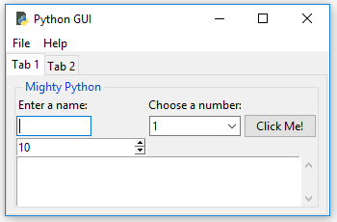
Look and Feel Customization Chapter 3
How to do it...
First, we add the Spinbox control by performing the following instructions:
Open GUI_title.py and save the module as GUI_spinbox.py.
Place the following code above the ScrolledText widget:
# Adding a Spinbox widget
spin = Spinbox(mighty, from_=0, to=10) spin.grid(column=0, row=2)
Run the code. This will modify our GUI as follows:

Slide 32
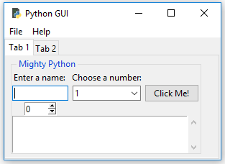
Look and Feel Customization
Chapter 3
Next, we will reduce the size of the Spinbox widget:
Open GUI_spinbox.py and save the module as GUI_spinbox_small.py.
Add a width attribute when creating the Spinbox widget:
spin = Spinbox(mighty, from_=0, to=10, width=5)
Running the preceding code results in the following GUI:

Slide 33
Look and Feel Customization
Chapter 3
Next, we add another attribute to customize our widget further; bd is short-hand notation for the borderwidth attribute, and changes the width of the border surrounding the spin box:
Open GUI_spinbox_small.py and save the module as GUI_spinbox_small_bd.py.
Add a bd attribute, giving it a size of 8:
spin = Spinbox(mighty, from_=0, to=10,
width=5 , bd=8)

Slide 34
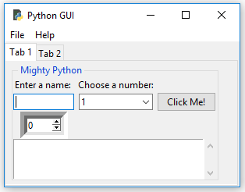
Look and Feel Customization
Chapter 3
3. Running the preceding code results in the following GUI:

Slide 35
Look and Feel Customization
Chapter 3
Next, we add functionality to the widget by creating a callback and linking it to the control.
The following steps show how to print the selection of the Spinbox widget into ScrolledText as well as onto stdout. The variable named scrol is our reference to the ScrolledText widget:
Open GUI_spinbox_small_bd.py and save the module as
GUI_spinbox_small_bd_scrol.py.
Write a callback function right above the creation of the Spinbox widget and assign it to the command attribute of the Spinbox: widget:
# Spinbox callback
def _spin():
value = spin.get() print(value)
scrol.insert(tk.INSERT, value + '\n')
# <-- add a newline
spin = Spinbox(mighty, from_=0, to=10, width=5, bd=8, command=_spin)
# <-- command=_spin

Slide 36
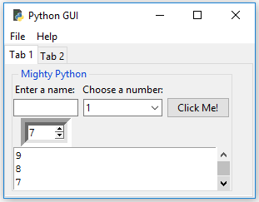
3. Running the GUI_spinbox_small_bd_scrol.py
file results in the following GUI when clicking the Spinbox arrows:

Slide 37
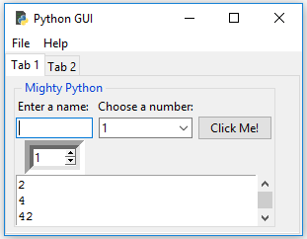
Instead of using a range, we can also specify a set of values by performing the following instructions:
Open GUI_spinbox_small_bd_scrol.py and save the module as
GUI_spinbox_small_bd_scrol_values.py.
Add the values attribute, replacing from_=0, to=10, and assign it a tuple of numbers during the creation of the Spinbox widget:
# Adding a Spinbox widget using a set of values
spin = Spinbox(mighty, values=(1, 2, 4, 42, 100), width=5, bd=8, command=_spin)
spin.grid(column=0, row=2)
Run the code. This will create the following GUI output:

Slide 38
Look and Feel Customization
Chapter 3
How it works…
Note how, in the first Python module, GUI_spinbox.py, our new Spinbox control defaulted to a width of 20, pushing out the column width of all controls in this column. This is not what we want. We gave the widget a range from 0 to 10.
- GUI_spinbox_small.py, we reduced the width of the
Spinbox control, which aligned it in the center of the column.
- GUI_spinbox_small_bd.py, we added the borderwidth attribute of the Spinbox, which automatically made the entire Spinbox appear no longer flat, but three-dimensional.
-GUI_spinbox_small_bd_scrol.py, we added a callback function to display the number chosen in the ScrolledText widget and also print it to the standard out stream. We added \n to insert the values on new lines within the callback function, def _spin().
Notice, when we click the control that the callback function gets called. By clicking the down arrow with a default of 0, we can print the 0 value.
Lastly, in GUI_spinbox_small_bd_scrol_values.py, we restricted the values available to a hardcoded set. This could also be read in the form of a data source (for example, a text or XML file).

Slide 39
6. Applying relief – the sunken and raised appearance of widgets
We can control the appearance of our Spinbox widgets by using an attribute that makes them appear in different formats, such as sunken or raised. This attribute is the relief attribute.
Look and Feel Customization Chapter 3
Getting ready
We will add one more Spinbox control to demonstrate the available appearances of widgets, using the relief attribute of the Spinbox control.

Slide 40
Look and Feel Customization Chapter 3
How to do it…
While we are creating the second Spinbox, let's also increase borderwidth to distinguish our second Spinbox from the first Spinbox:
Open GUI_spinbox_small_bd_scrol_values.py and save the module as
GUI_spinbox_two_sunken.py.
Add a second Spinbox just below the first Spinbox and set bd=20:
# Adding a second Spinbox widget
spin2 = Spinbox(mighty, values=(0, 50, 100), width=5, bd=20, command=_spin2)
# <-- new function spin2.grid(column=1, row=2)
We will also create a new callback function for the command attribute, _spin2. Place this function above the code just shown, where we create the second Spinbox:
# Spinbox2 callback function
def _spin2():
value = spin2.get() print(value)
scrol.insert(tk.INSERT, value + '\n’)
# <-- write to same ScrolledText

Slide 41
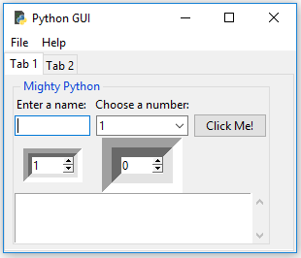
Look and Feel Customization
Chapter 3
4. Run the code. This will create the following GUI output:
Our two spin boxes look different but this is only because of the difference in the borderwidth (bd) we specified. Both widgets look three-dimensional, and this is much more visible in the second Spinbox that we have added.
They actually both have a relief style even though we did not specify the relief
attribute when we created the spin boxes.

Slide 42
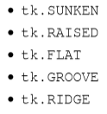
Look and Feel Customization
Chapter 3
+ When not specified,
the relief style defaults to SUNKEN.
+ Here are the available relief attribute options that can be set:
By assigning the different available options to the relief attribute , we can create different appearances for this widget.

Slide 43
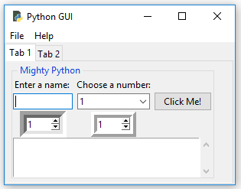
Assigning the tk.RIDGE relief and reducing the border width to the same value as our first
Spinbox widget results in the following GUI:
Open GUI_spinbox_two_sunken.py and save the module as
GUI_spinbox_two_ridge.py.
Set relief to tk.RIDGE:
spin2 = Spinbox(mighty, values=(0, 50, 100), width=5, bd=9, command=_spin2, relief=tk.RIDGE)
Run the code. The following GUI is obtained after running the code:

Slide 44
Notice the difference in appearance of our second Spinbox widget, on the right.
Now, let's go behind the scenes to understand the code better.
How it works…
First, we created a second Spinbox aligned in the second column (index == 1). It defaults to SUNKEN, so it looks similar to our first Spinbox. We distinguished the two widgets by increasing the border width of the second control (the one on the right).

Slide 45
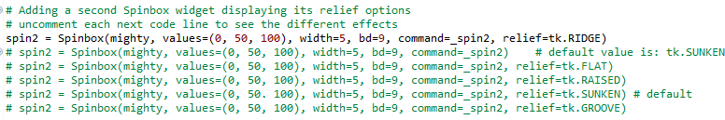

Look and Feel Customization Chapter 3
Next, we explicitly set the relief attribute of the Spinbox widget. We made borderwidth the same as our first Spinbox because, by giving it a different relief, the differences became visible without having to change any other attributes.
Here is an example of the different relief options, GUI_spinbox_two_ridge.py:
And here is a screenshot of what those relief attributes create:
We've successfully learned how to use and apply relief, sunken, and raised appearances to widgets. Now, let's move on to the next recipe.

Slide 46
7. Creating tooltips using Python
This recipe will show you how to create tooltips. When the user hovers the mouse over a widget, additional information will be available in the form of a tooltip.
We will code this additional information into our GUI.
Getting ready
We will be adding more useful functionality to our GUI. Surprisingly, adding a tooltip to our controls should be simple, but it is not as simple as we'd want it to be.
In order to achieve this desired functionality, we will place our tooltip code in its own OOP class.

Slide 47
Look and Feel Customization
Chapter 3
How to do it…
These are the steps to create a tooltip:
Open GUI_spinbox_small_bd_scrol_values.py and save the module as GUI_tooltip.py.
Add the following class just below the import statements:
class ToolTip(object):
def init (self, widget, tip_text=None):
self.widget = widget
self.tip_text = tip_text
widget.bind('<Enter>', self.mouse_enter)
widget.bind('<Leave>', self.mouse_leave)
Add two new methods to the class below init:
def mouse_enter(self, _event): self.show_tooltip()
def mouse_leave(self, _event): self.hide_tooltip()

Slide 48
Look and Feel Customization
Chapter 3
Add another method below these two, and name the method show_tooltip:
def show_tooltip(self):
if self.tip_window:
x_left = self.widget.winfo_rootx()
y_top = self.widget.winfo_rooty() – 18
self.tip_window = tk.Toplevel(self.widget)
self.tip_window.overrideredirect(True)
self.tip_window.geometry("+%d+%d" % (x_left, y_top))
label = tk.Label(self.tip_window, text=self.tip_text, justify=tk.LEFT, background="#ffffe0", relief=tk.SOLID, borderwidth=1, font=("tahoma", "8", "normal"))
label.pack(ipadx=1)
Add another method below show_tooltip, and name it hide_tooltip:
def hide_tooltip(self):
if self.tip_window:
self.tip_window.destroy()

Slide 49
Look and Feel Customization Chapter 3
Below the class and below the code where we create the Spinbox widget, create an instance of the ToolTip class, passing in the Spinbox variable, spin:
# Adding a Spinbox widget
spin = Spinbox(mighty, values=(1, 2, 4, 42, 100), width=5, bd=9, command=_spin) spin.grid(column=0, row=2)
# Add a Tooltip to the Spinbox
ToolTip(spin, 'This is a Spin control')# <-- add this code
Perform the same step for the ScrolledText widget just below the Spinbox widget:
scrol = scrolledtext.ScrolledText(mighty, width=scrol_w, height=scrol_h, wrap=tk.WORD)
scrol.grid(column=0, row=3, sticky='WE', columnspan=3)
# Add a Tooltip to the ScrolledText widget
ToolTip(scrol, 'This is a ScrolledText widget’)
# <-- add this code

Slide 50
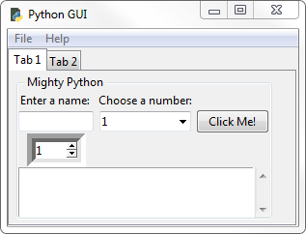
Look and Feel Customization Chapter 3
Run the code and hover the mouse over the ScrolledText widget:
Now, let's go behind the scenes to understand the code better.

Slide 51
Look and Feel Customization
Chapter 3
8. Adding Progressbar to the GUI
In this recipe, we will add a Progressbar to our GUI. It is very easy to add a ttk.Progressbar, and we will demonstrate how to start and stop a Progressbar. This recipe will also show you how to delay the stopping of a Progressbar, and how to run it in a loop.
A Progressbar is typically used to show the current status of a long-running process.
Getting ready
We will add Progressbar to Tab 2 of the GUI that we developed in a previous recipe:
Using a spin box control.

Slide 52
Look and Feel Customization
Chapter 3
How to do it…
Here are the steps to create a Progressbar and some new Buttons that start and stop the Progressbar:
Open GUI_spinbox_small_bd_scrol_values.py and save the module as GUI_progressbar.py.
At the top of the module, add sleep to the imports:
from time import sleep
# careful - this can freeze the GU

Slide 53
Look and Feel Customization
Chapter 3
Add Progressbar below the code where we create the three Radiobutton widgets:
# Now we are creating all three Radiobutton widgets within one loop
for col in range(3):
curRad = tk.Radiobutton(mighty2, text=colors[col], variable=radVar, value=col, command=radCall)
curRad.grid(column=col, row=1, sticky=tk.W) # row=6
# Add a Progressbar to Tab 2 # <--- add this code here
progress_bar = ttk.Progressbar(tab2, orient='horizontal', length=286, mode='determinate') progress_bar.grid(column=0, row=3, pady=2)

Slide 54
Look and Feel Customization
Chapter 3
4. Next, we write a callback function to update Progressbar:
# update progressbar in callback loop def run_progressbar():
progress_bar["maximum"] =100
for i in range(101):
sleep(0.05)
progress_bar["value"] = i progress_bar.update()
progress_bar["value"] = 0
# increment progressbar
# have to call update() in loop
# reset/clear progressbar

Slide 55
Look and Feel Customization
Chapter 3
We then write the following three functions below the preceding code:
def start_progressbar(): progress_bar.start()
def stop_progressbar(): progress_bar.stop()
def progressbar_stop_after(wait_ms=1000): win.after(wait_ms, progress_bar.stop)

Slide 56
Look and Feel Customization
Chapter 3
We will reuse buttons_frame and LabelFrame, but replace the labels with new code. Change the following code:
# PREVIOUS CODE -- REPLACE WITH BELOW CODE
# Create a container to hold labels
buttons_frame = ttk.LabelFrame(mighty2, text=' Labels in a Frame ')
buttons_frame.grid(column=0, row=7)
# NEW CODE
# Create a container to hold buttons
buttons_frame = ttk.LabelFrame(mighty2, text=' ProgressBar ')
buttons_frame.grid(column=0, row=2, sticky='W', columnspan=2)

Slide 57
Look and Feel Customization
Chapter 3
Delete the previous labels that resided in buttons_frame:
# DELETE THE LABELS BELOW
# Place labels into the container element ttk.Label(buttons_frame, text="Label1").grid(column=0, row=0, sticky=tk.W)
ttk.Label(buttons_frame, text="Label2").grid(column=1, row=0, sticky=tk.W)
ttk.Label(buttons_frame, text="Label3").grid(column=2, row=0, sticky=tk.W)

Slide 58
Look and Feel Customization
Chapter 3
Create four new buttons. buttons_frame is their parent:
# Add Buttons for Progressbar commands
ttk.Button(buttons_frame, text=" Run Progressbar ", command=run_progressbar).grid(column=0, row=0, sticky='W')
ttk.Button(buttons_frame, text=" Start Progressbar ", command=start_progressbar).grid(column=0, row=1, sticky='W')
ttk.Button(buttons_frame, text=" Stop immediately ", command=stop_progressbar).grid(column=0, row=2, sticky='W')
ttk.Button(buttons_frame, text=" Stop after second ",
command=progressbar_stop_after).grid(column=0, row=3, sticky='W')

Slide 59
Look and Feel Customization
Chapter 3
Add additional padding for the children of buttons_frame in a loop:
for child in buttons_frame.winfo_children():
child.grid_configure(padx=2, pady=2)
Add additional padding for all children of Tab2:
for child in mighty2.winfo_children(): child.grid_configure(padx=8, pady=2)

Slide 60
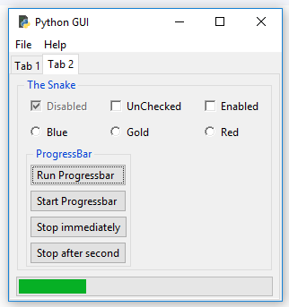
Look and Feel Customizatio Chapter 3
11. Run the code. The following GUI is obtained after clicking the Run Progressbar button:

Slide 61
Look and Feel Customization Chapter 3
9. Use the canvas widget
This recipe shows how to add dramatic color effects to our GUI by using the tkinter canvas widget.
Getting ready
We will improve our previous code from GUI_tooltip.py, and we'll improve the look of our GUI by adding some more colors to it.

Slide 62
Look and Feel Customization
Chapter 3
How to do it…
First, we will create a third tab in our GUI in order to isolate our new code.
Here is the code to create the new third tab:
Open GUI_tooltip.py and save the module as GUI_canvas.py.
Create a third tab control:
tabControl = ttk.Notebook(win) # Create Tab Control
tab1 = ttk.Frame(tabControl)
tabControl.add(tab1, text='Tab 1')
# Create a tab
# Add the tab
tab2 = ttk.Frame(tabControl)
tabControl.add(tab2, text='Tab 2')
# Add a second tab
tab3 = ttk.Frame(tabControl)
tabControl.add(tab3, text='Tab 3')
# Add a third tab
tabControl.pack(expand=1, fill="both")
# Pack to make tabs visible

Slide 63
Look and Feel Customization
Chapter 3
3. Next, we use another built-in widget of tkinter, called Canvas. A lot of people like this widget because it has powerful capabilities:
# Tab Control 3
tab3_frame = tk.Frame(tab3, bg='blue') tab3_frame.pack()
for orange_color in range(2):
canvas = tk.Canvas(tab3_frame, width=150, height=80, highlightthickness=0, bg='orange')
canvas.grid(row=orange_color, column=orange_color)

Slide 64
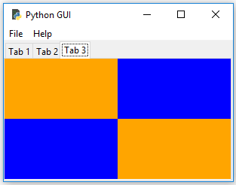
Look and Feel Customization Chapter 3
4. Run the GUI_canvas.py file. The following GUI is obtained after running the code:
How it works…
After we have created the new tab, we place a regular tk.Frame into it and assign it a background color of blue. In the loop, we create two tk.Canvas widgets, making their color orange and assigning them to the grid coordinates 0,0 and 1,1. This also makes the blue background color of the tk.Frame visible in the two other grid locations.

Slide 65
BÀI TẬP THỰC HÀNH LAB 3

Slide 66
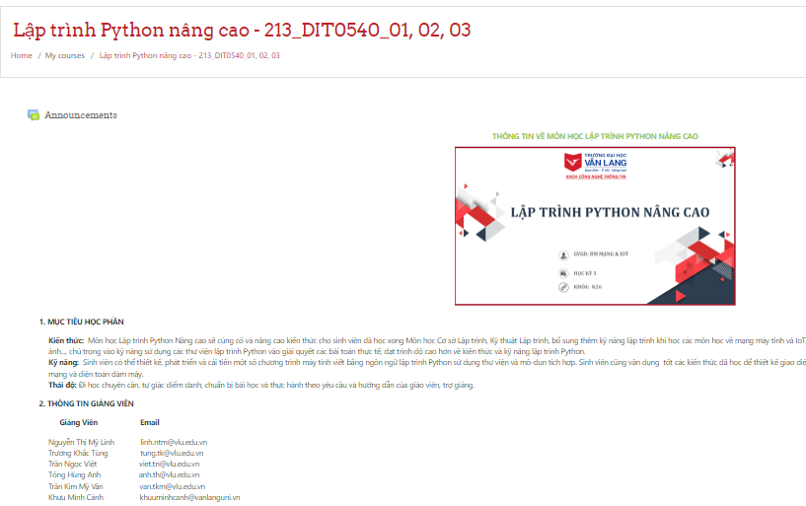
Trên trang elearning:
https://elearning.vanlanguni.edu.vn/course/view.php?id=13473

Slide 67
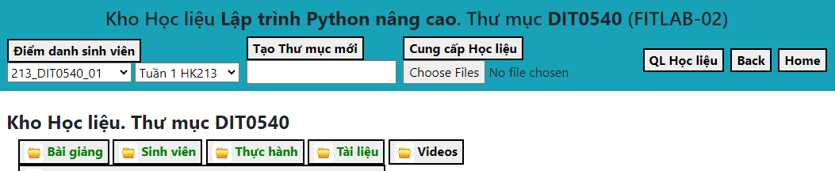
NOTE:
+ Sinh viên điểm danh trên online Lab
https://fit-lab.vlu.edu.vn
+ SV nộp bài tập trên lớp vào online lab:
Blended Classes/ Lập trình Python NC/

